Slide 1
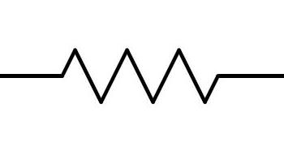
Series
Parallel

Slide 2

Series
Parallel

Slide 3

Series
Parallel

